Slide 1
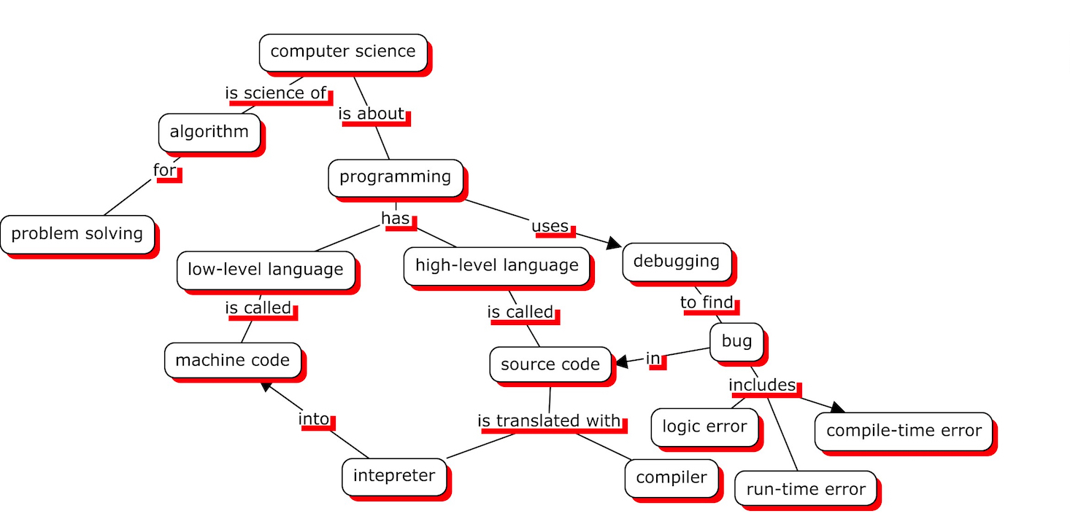
KM-1: Visualization of knowledge graphs of book contents
Tianyang Zhou, 2589435
Lin Li,2378303
K.Yasemin Usta, 2524571
16.07.2019

Slide 2


Visualization of knowledge graphs of book contents
Motivation: Help user to read a book with concept map approach
vs
General Book Reading
Book Reading with our tool
Boring
Lengthy
Static
Interactive
Focused on concepts
Exercises, Modifications

Slide 3
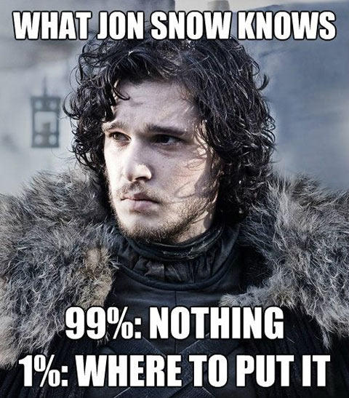
Case: Teach Jon Snow Java
Let’s take a tour of our web application with a scenario.
Scenario: One day, Jon Snow wants to learn about Java and heard about our web application.

Slide 4
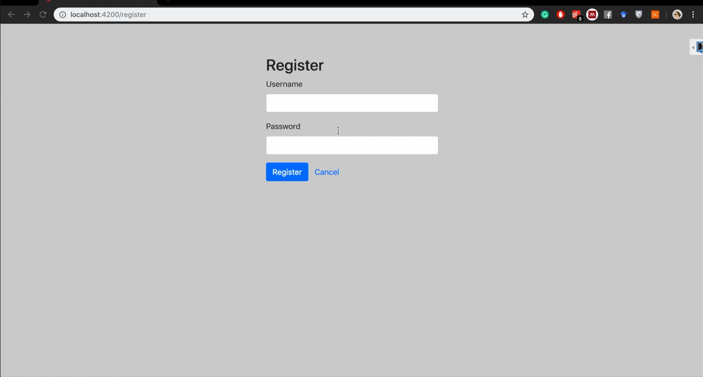
Case: Teach Jon Snow Java
First, he needs to register to the web site and login to account to save his progress.
Notes:
He liked Think Java book
Selected “Think Java”
Checked its macro concept map

Slide 5
Macro and Micro Map
Hierarchical structure
Easy to understand
Macro Map
Micro Map 4
Micro Map 1
Micro Map 3
Micro Map 2

Slide 6

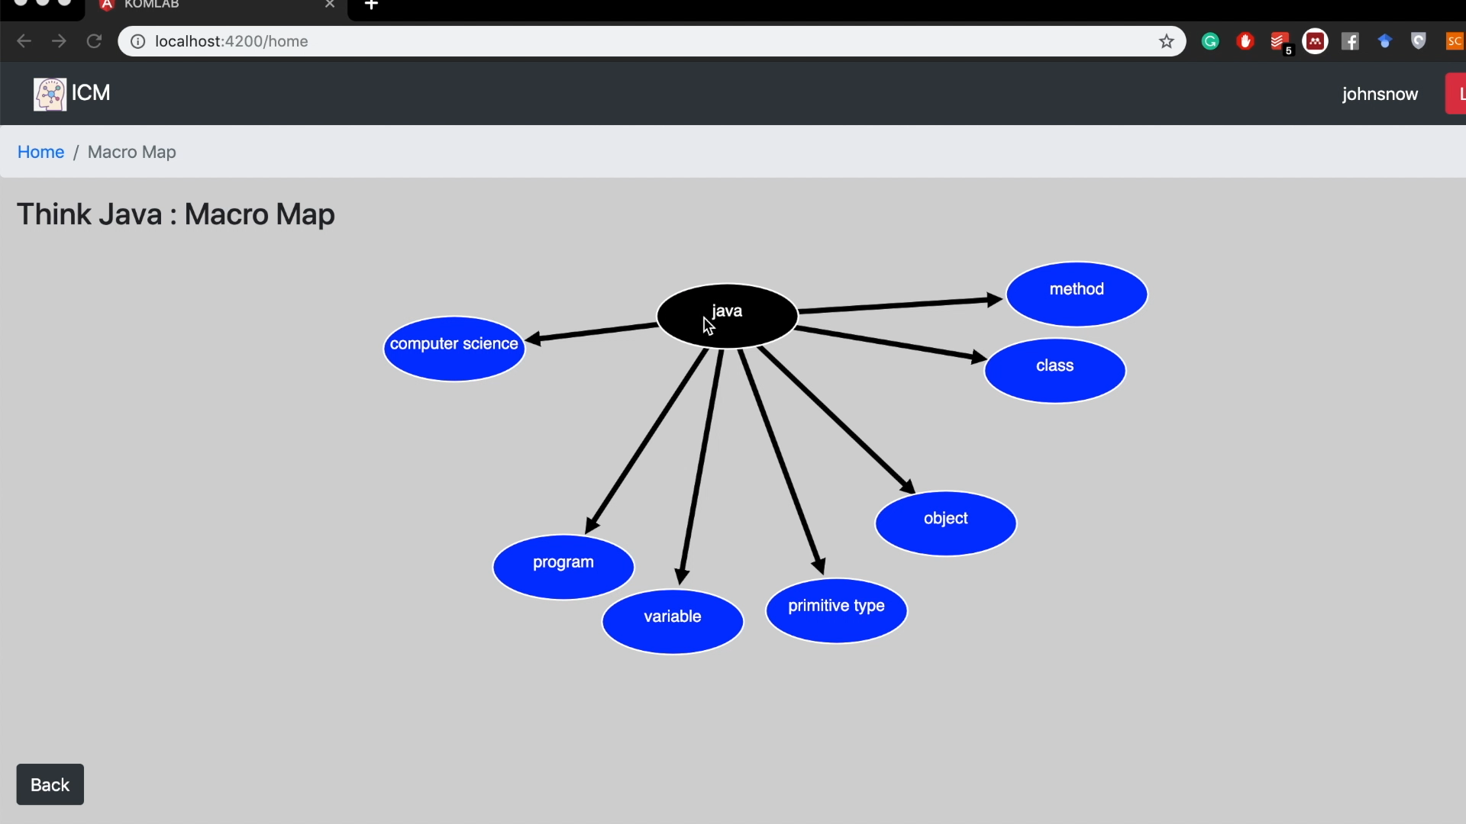
Case: Teach Jon Snow Java
Notes:
Enter to an interesting micro concept map from macro map
He is a newbie so started with learning “computer science”

Slide 7
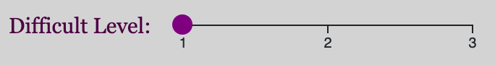
Difficult Level
Motivation: Lots of concepts -> No structure, Hard to follow
Hiding some concepts
Show a way of learning order
Easy
Normal
Hard

Slide 8
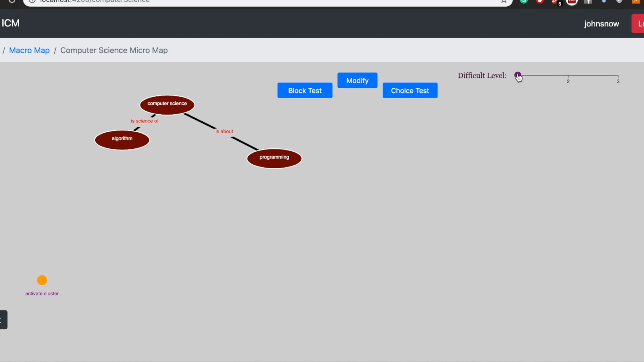
Case: Teach Jon Snow Java
Notes:
He can set difficult level to unlock more concepts while learning
Color Map (Green, Red)

Slide 9
Glossary and PDF
Motivation: Lots of reading -> No structure,Time consuming
Sentence in glossary box
Provide related information
Go to related pdf page
Need more

Slide 10
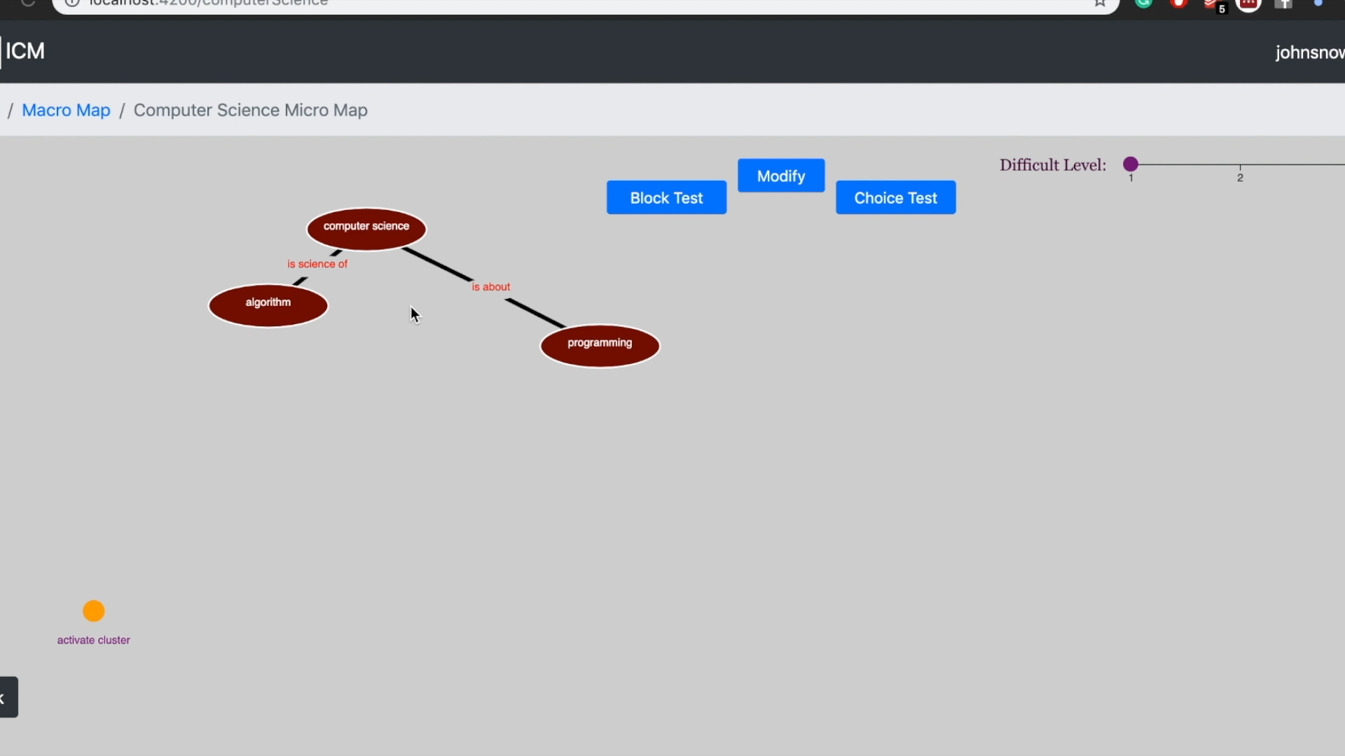
Case: Teach Jon Snow Java
Notes:
He can directly see related sentence in the glossary, and go to related page in book with a simple click.

Slide 11
Exercises and Clusters
Motivation: Without practice, it is easy to forget. Don’t know the progress
Provide different exercises
Help user to remember
Evaluate learning progress
Group concepts together
Show progress
Distinguish from other maps

Slide 12
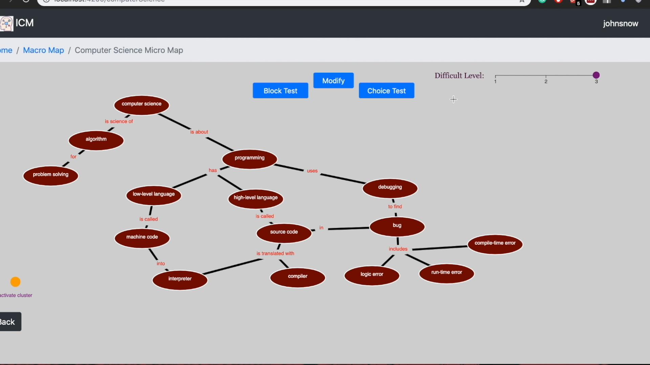
Case: Teach Jon Snow Java
Notes:
Filling blank test will help him remember the concepts’ names and connections.

Slide 13
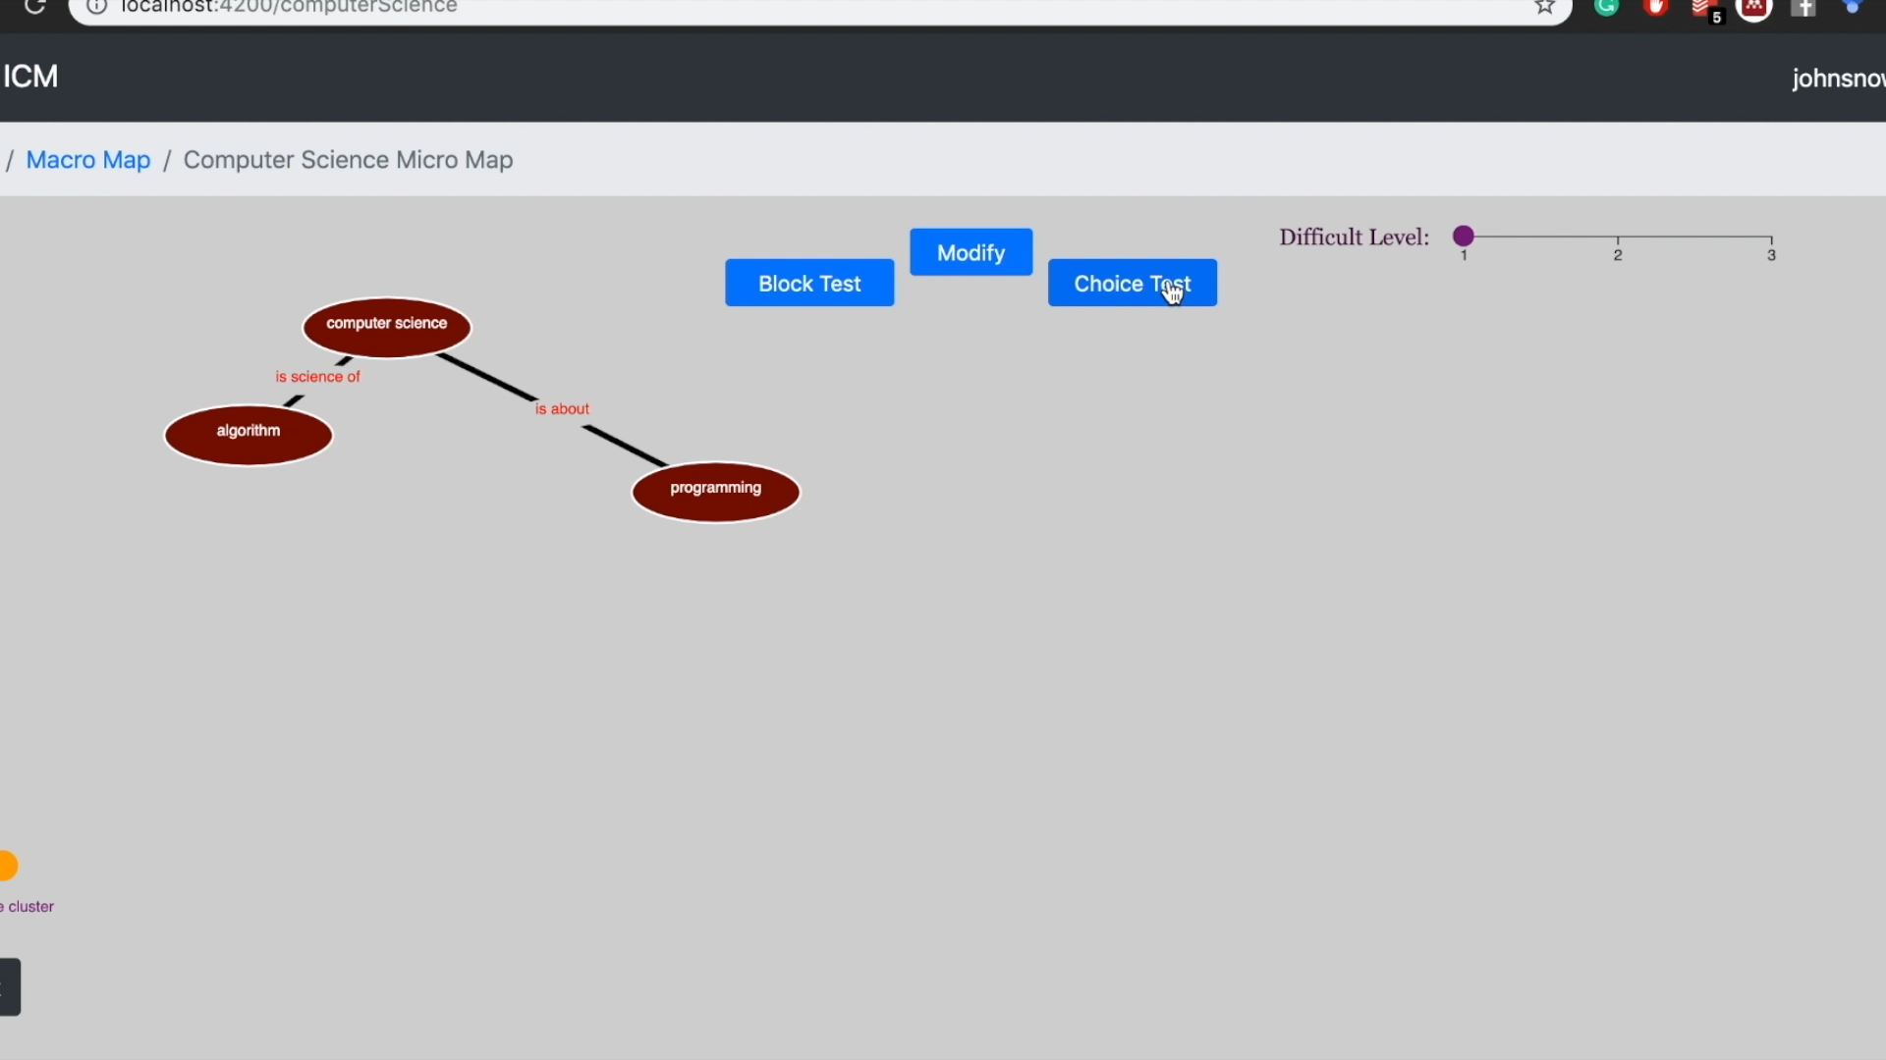
Case: Teach Jon Snow Java
Notes:
Single choice test will help him remember the concepts’ meaning.

Slide 14
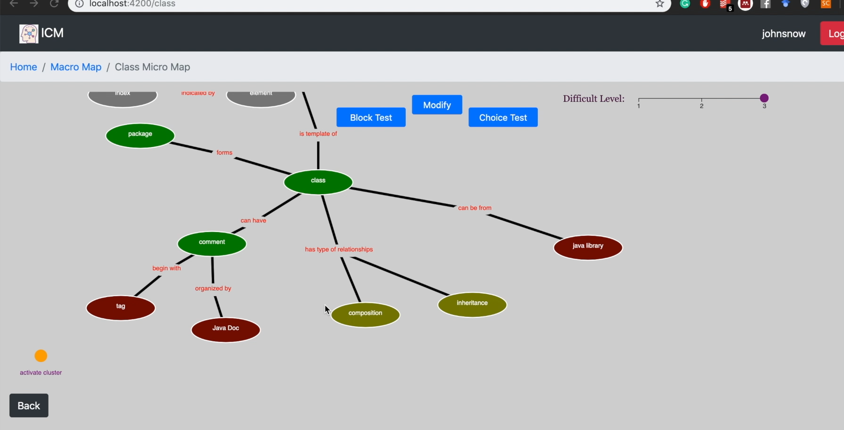
Case: Teach Jon Snow Java
Notes:
Both tests’ result will be represented in the micro map with colors and text.

Slide 15
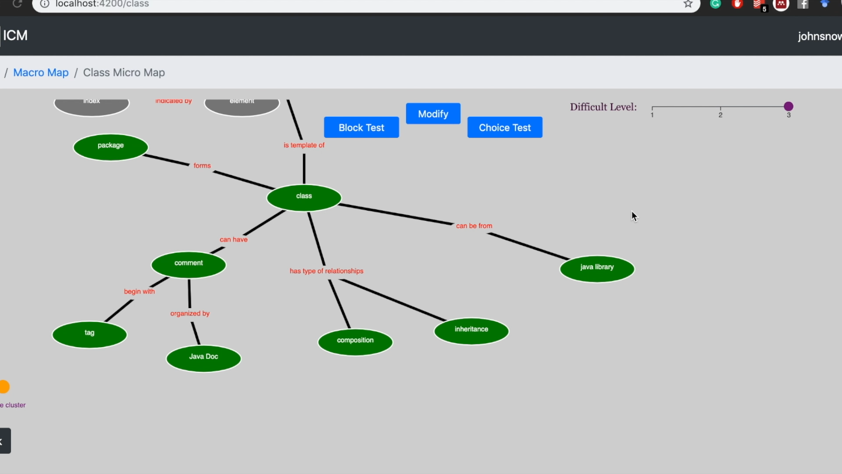
Case: Teach Jon Snow Java
Notes:
When he finished learning the concepts in one map, he can directly jump to another new map.

Slide 16
Modify Mode
Motivation: Everyone has different focus.
Provide build or modify mode
Help user to create their maps
*Developers, easy to update their maps according book version

Slide 17
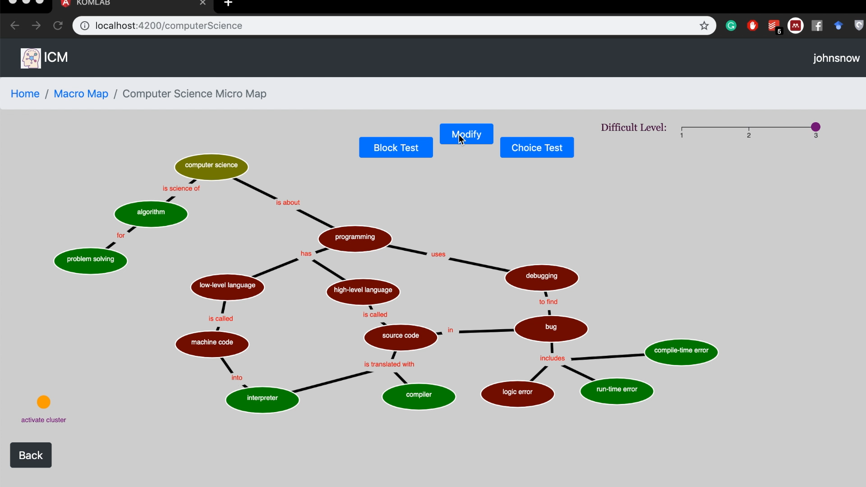
Case: Teach Jon Snow Java
Notes:
Modification
Concept : Drag, Modify, Delete , Linkword: Show them
Add a node
add a link word
show a link arrow
save it

Slide 18
Main Challenges
Like all projects we had challenges :
Solution:
ng2-pdf-viewer
library
Problem:
Change & add
features
on SVG
Solution:
Add
Foreign Object
Element
Problem:
Link concept
and book
Solution:
Angular 8+
Node.js server
Solution:
D3 Library
Problem:
Modify data
on JSON file
Problem:
Show
concept map
Notes:
Changing and adding features and svg items (solved by, Foreign Objects)
Linking between concept and books pdf (solved by, ng2-pdf-viewer tool)
Showing the graph of concepts (solved by, d3 library)
Faking backend for login, registration and authentication (solved by, HTML5 local storage and Json file)
Implementing CRUD methods (Create, Read, Update and Delete) on Json file (upgraded Angular version 8+,adding a nodejs s

Slide 19
Future Works
Integrate multimedia resources (Youtube, Udemy)
Extend modify mode into an assignment system
Adding a feedback mechanism for developer
Adding more exercises
Improving its front-end design

Slide 20
Self-Critical Discussion
Advantages
Learned Angular and created a simple web application
A good experience for working with team
Disadvantages
Better front-end design with SVG
Hard to merge codes (sometimes)
In the end: We tried our best.

Slide 21

Thank you for your attention! Questions?
And Here Start My Watch
For Questions !!!

